Slide 1

Analysis of Popular Bikes in India
Presented by – Sathvika Gogula

Slide 2
About me
Name : Sathvika Gogula
Background: B.Tech Biomedical Engineering, SRM University, Chennai.
• Why Data Science: To develop my skills in data analysis, Python, and machine learning and build a career in Data Science.
• Work Experience: Fresher.
• LinkedIn: https://www.linkedin.com/in/gogula-sathvika-6a182031b?utm_source=share_via&utm_content=profile &utm_medium=member_android
Github : https://github.com/gogulasathvika-hub/Analysis_Popular_Bikes_India.git

Slide 3
Table of contents
Business Problem
Project Objectives
Introduction
Tools and Technologies
Data Collection
Dataset Description
Data Cleaning
Univariate Analysis
Bivariate Analysis
Multivariate Analysis
Statistical Analysis
Hypothesis Testing — ANOVA
Recommendations
Conclusion

Slide 4
Business Problem
The Indian bike market offers many models with different prices, mileage, engine capacities, power, and customer ratings.
Customers may find it difficult to compare these specifications and identify a bike that suits their needs and budget.
Bike information is available for different models, but comparing multiple features together can be time-consuming.
Differences in price, mileage, engine capacity, and power make it challenging to evaluate bikes based on their overall features.
Customers need a clear comparison of bike specifications to understand the advantages of different models.

Slide 5
Project Objectives
Data Collection: Collect information about different bike models in India, including price, mileage, engine capacity, power, weight, and customer ratings.
Feature Analysis: Analyze important bike specifications to understand differences in performance, fuel efficiency, and pricing across various models.
Bike Comparison: Compare different bike models based on their features, prices, and ratings to identify suitable options across different price ranges.
Statistical Analysis: Examine the relationship between bike price and mileage and compare average prices across different brands to identify useful patterns.
Visualization and Insights: Present the findings using charts and graphs to identify highly rated bikes, mileage-efficient models, and useful comparisons that support purchasing decisions.

Slide 6
Introduction
The Indian two-wheeler market offers a wide range of bikes designed for different customer needs, budgets, and riding preferences.
Bike specifications such as price, mileage, engine capacity, power, weight, and customer ratings are important factors when comparing different models.
This project focuses on analyzing information about 30 bike models collected from the BikeWale website to understand their features and differences.
Python libraries were used to collect, organize, clean, and analyze the data, making it easier to compare bike models systematically.
The project uses data analysis, statistical techniques, and visualizations to identify patterns in pricing, mileage, ratings, and other bike features.

Slide 7
Tools and Technologies
Python: Used for data collection, cleaning, and analysis.
Requests: Used to retrieve webpage content from BikeWale.
BeautifulSoup: Used to extract bike details from HTML content.
Pandas and NumPy: Used to organize and process the dataset.
Matplotlib and Seaborn: Used to create charts and visualize the results.

Slide 8
Data Collection
Data Source: Bike information was collected from the BikeWale website, which provides specifications of different bike models available in India.
Webpage Access: The Requests library was used to send HTTP requests and retrieve the webpage content.
Data Extraction: BeautifulSoup was used to parse the HTML content and extract the required bike details.
Data Organization: The extracted information was organized into a structured Pandas DataFrame for further processing and analysis.
Dataset Size: A total of 30 bike models were collected, with 9 features for each bike.
Website: https://www.bikewale.com/new-bike-search/

Slide 9
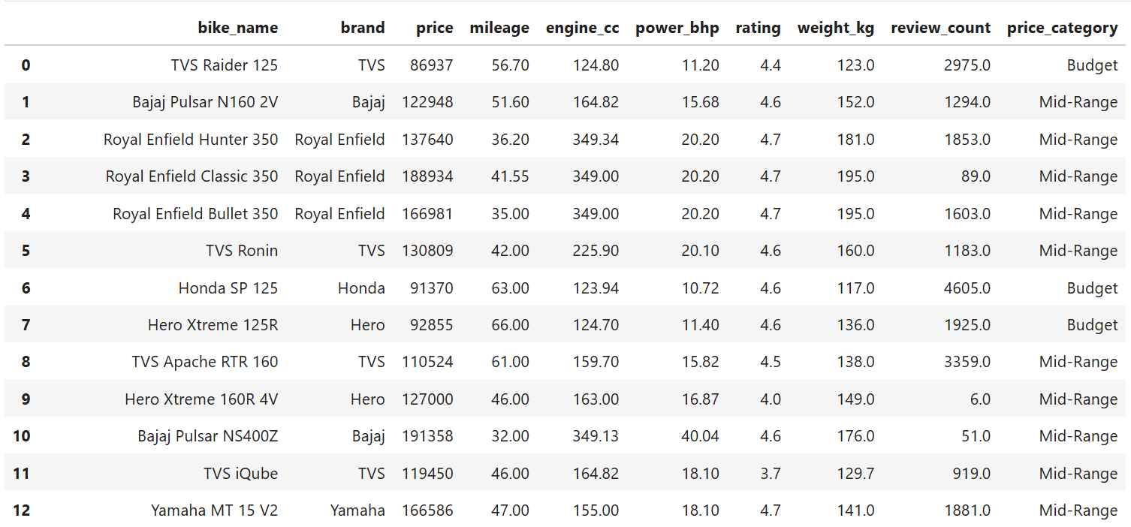
Dataset Description
Dataset Overview: The final dataset contains 30 rows and 9 columns.

Slide 10
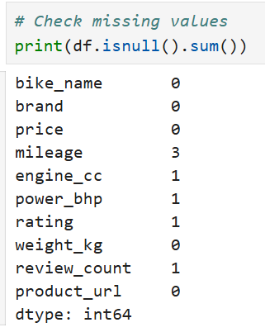
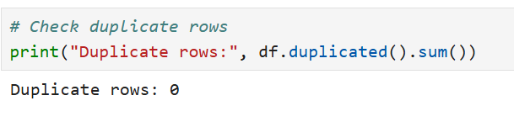
Data Cleaning
Data Inspection: Checked the dataset structure, column names, and data types to understand the collected information.
Missing Values: Identified missing values in numerical columns and filled them using the median to retain the available records.
Duplicate Check: Checked for duplicate records to avoid repeated entries affecting the analysis.
Data Standardization: Corrected inconsistent brand names to maintain uniformity in the dataset.

Slide 11
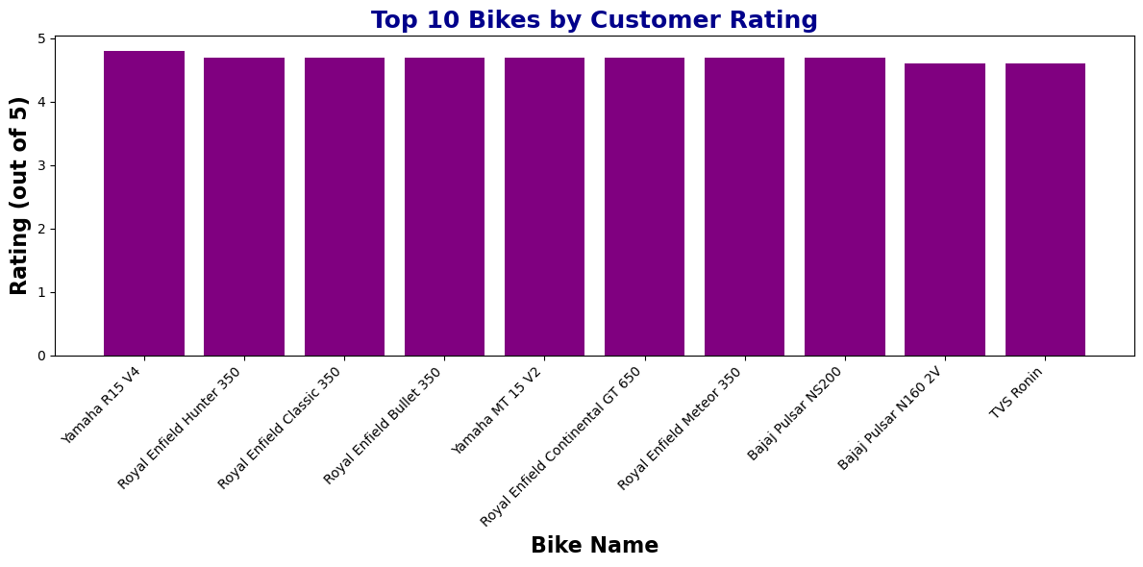
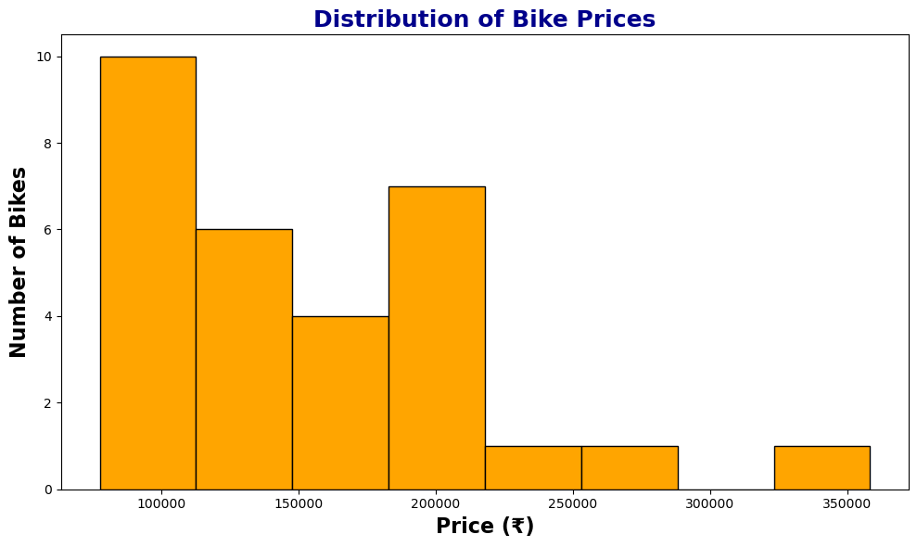
Univariate Analysis
The collected dataset of 30 bikes was analyzed to understand pricing patterns, customer ratings, and differences between bike models.
1. Top 10 Rated Bikes
Yamaha R15 V4 received the highest rating of 4.8 among the collected bikes.
2. Distribution of Bike Prices
The average price of the 30 bikes was ₹1,52,140.13.

Slide 12
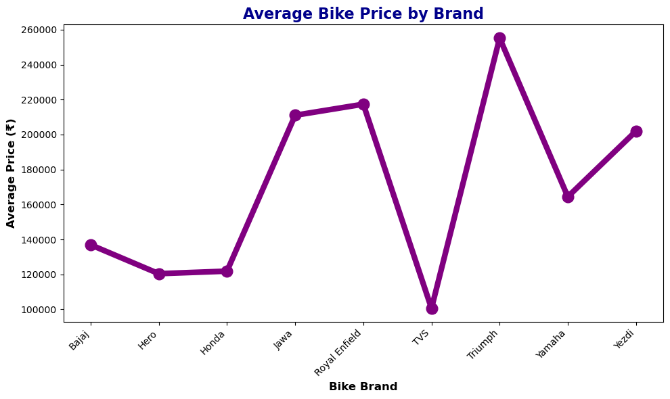
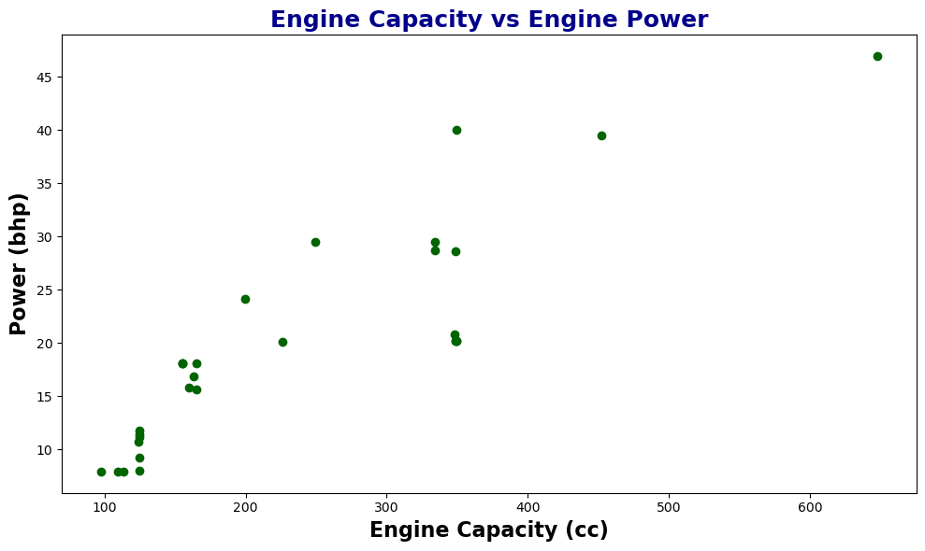
Bivariate Analysis
The relationship between engine capacity and power was examined, and the average prices of bike models across different brands was analyzed.
1. Average Price by Brand
Compared the average prices of bike models across different brands.
Identified differences in pricing among the brands represented in the dataset.
2. Engine Capacity vs Power
Compares engine capacity (CC) with power (BHP).
Helps identify how engine size and power vary across bike models.

Slide 13
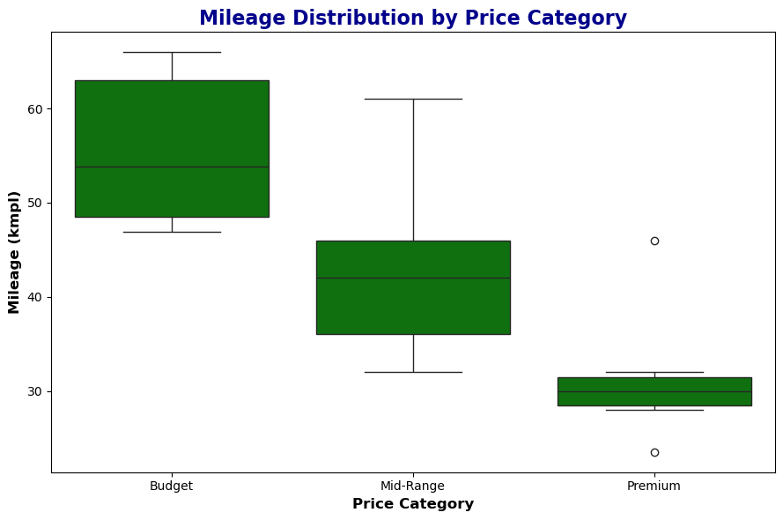
Bivariate Analysis
The analysis examined how mileage varies across bike price categories.
3. Mileage by Price Category
Compares mileage across Budget, Mid-Range, and Premium bikes.
Shows differences in median mileage, spread, and possible outliers.

Slide 14
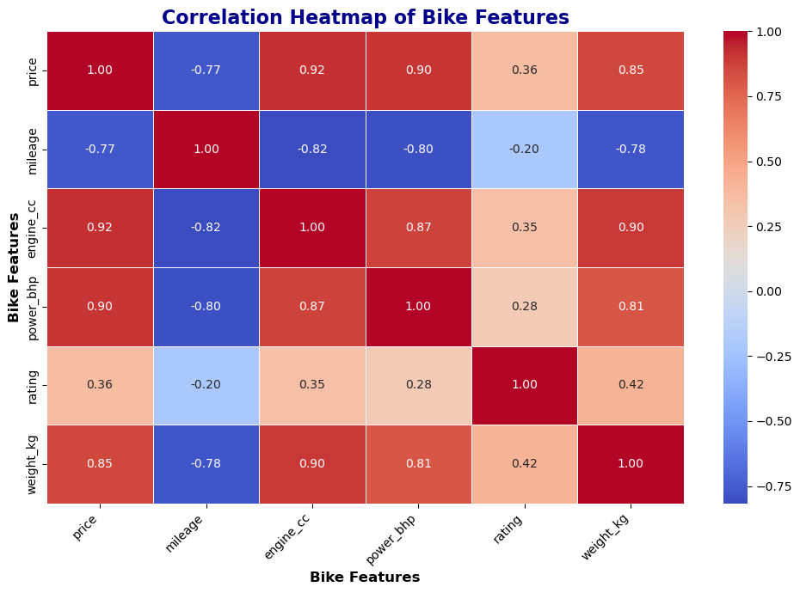
Multivariate Analysis
Correlation Heatmap
Displays relationships between numerical bike features.
Price and mileage showed a correlation of −0.77.

Slide 15
Statistical Analysis
Statistical Measure | Result
Total bikes | 30
Average price | ₹1,52,140.13
Average mileage | 44.06 km/l
Average rating | 4.5
Price–mileage correlation | −0.77
ANOVA p-value | 0.0108
The average bike price is ₹1,52,140.13, with an average mileage of 44.06 km/l across the 30 bikes.
The average customer rating is 4.5, indicating generally positive ratings in the collected dataset.
Price and mileage have a strong negative correlation (−0.77), meaning higher-priced bikes tend to have lower mileage in this sample.
ANOVA (p = 0.0108) indicates a statistically significant difference in average prices among the brand groups analyzed.

Slide 16
Hypothesis Testing
Hypothesis Testing — ANOVA
Null Hypothesis (H₀): The mean bike prices are equal across the tested brand groups.
Alternative Hypothesis (H₁): At least one brand group's mean bike price is different.
Test Used: One-Way ANOVA
Significance Level: 5% (0.05)
Decision Rule:
If p-value < 0.05, reject H₀.
If p-value ≥ 0.05, fail to reject H₀.
Conclusion:
F-statistic: 3.976
P-value: 0.0108
Since the p-value is less than 0.05, reject H₀. There is a statistically significant difference in mean bike prices across the tested brand groups.

Slide 17
Recommendations
Include more bike models and manufacturers to improve dataset coverage.
Collect additional details such as maintenance costs, safety ratings, and service expenses.
Update bike prices and specifications regularly to keep the dataset current.
Develop an interactive dashboard to compare bikes based on price, mileage, engine capacity, and ratings.
Build a bike recommendation system based on users’ budgets and riding preferences.

Slide 18
Conclusion
The project collected and analyzed data on 30 bike models from the BikeWale website using Python.
The dataset was cleaned and organized with 9 features for further analysis.
Visualizations helped compare bike prices, mileage, engine capacity, power, and customer ratings.
Yamaha R15 V4 received the highest rating of 4.8, while Hero Xtreme 125R recorded the highest mileage of 66 km/l in the collected dataset.
Statistical analysis identified a strong negative relationship between price and mileage, with a correlation coefficient of −0.77.
Overall, the project demonstrates how data analysis and statistical techniques can help compare bikes and identify useful insights.

Slide 19

THANK YOU

